Slide 1
Principles and Practices of Management
UNIT-1

Slide 2
Meaning & Nature of Management

Slide 3
Learning Objectives
Meaning of Management
Management as a Process
Levels of Management
Managerial Skills
Qualities of a Successful Managers
Responsibilities and Roles of a Managers

Slide 4
Meaning & Nature of Management
In the modern world, one should utilize economically & efficiently, resources of all kinds- human, physical, technological, financial, intangible etc.
Management plays a catalytic role in optimizing the use of these resources.
The people who manage the resources in organization is known as Manager.
The knowledge, skills, techniques and practices; they use in managing are broadly referred to the Field of Management.

Slide 5
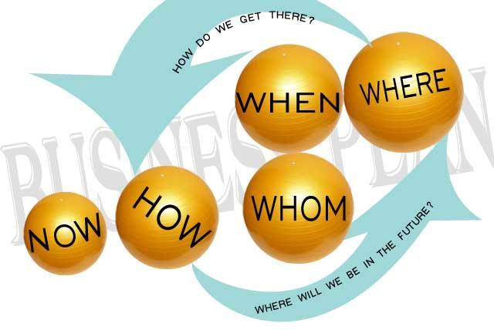
Meaning & Nature of Management [Contd..]
Management is a broad field as it is an attempt to create a desirable future, keeping the past and present in Mind.
Thus Management is the process that unifies various resources together and co-ordinate them to help accomplish the organizational goal.

Slide 6
Definitions of Management
Definitions can be categorized on the basis of:
Art of Getting Things Done:
The Term Management refers to the process of getting things done, effectively and efficiently, through and with people.
It is also the art of creating friendly environment in which people can perform as individuals and yet cooperate towards achievement of group and organizational goal.
The primary job of management is to convert the disorganized resources of men, money, machines, methods and materials into a productive organization.
Management is the practice of continually shaping organizations.

Slide 7
Definitions of Management [Contd…]
Process of Managing:
Management is called a PROCESS as it involves a series of functions as shown:
This process consists of planning, organizing, staffing, directing and controlling.
It utilizes both human and other resources.
It leads to accomplishment of predetermined objectives.
It starts with planning and ends with controlling but they always do not maintain a rigid sequence.
A practical manager performs all the functions simultaneously as management is a never ending process

Slide 8
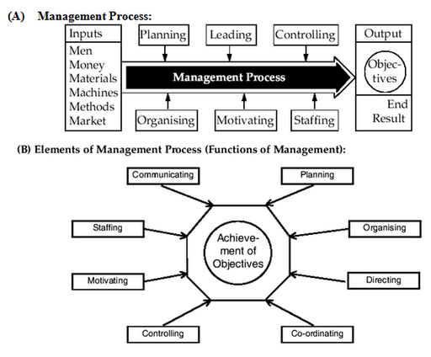
Contd…..

Slide 9
Definitions of Management [Contd…]
Management as a group of Team/ Managers:
Management is a group or team of managers who together carry out various managerial activities in the form of POSDC.
It includes all managers from CEO to the first line supervisors.
Practically, the term management is used to indicate only the TOP MANAGEMENT that has the authority for making important decisions like introduction of a new product, issue of shares, joint venture with MNCs etc.

Slide 10
Definitions of Management [Contd…]
Management as a Discipline or Field of study: Management is the organized body of knowledge which can be learnt in business schools & Institutes which consists of principles, practices, techniques and skills of management that help in achieving organizational objectives.

Slide 11
Management Systems and Processes
Management is regarded as an Integrating Process as it integrates all human efforts with non-human resources like materials, machines, methods, money etc. by their concerted efforts.
Management is regarded as a Social Process as every manager is required to use various skills of human relations to achieve good relations with the various groups of stakeholders like shareholders, workers, consumers, government, suppliers etc.
A process is a systematic way of doing things.

Slide 12
Management Systems and Processes
DEFINITION:
•F.W. Taylor -“Art of knowing what you want to do and then seeing that it is done the best and cheapest way”.
•Henry Fayol –“To Manage is to forecast, to plan, to organize, to command, to co-ordinate and to control”.
•Peter F.Drucker –”Management is work and as such it has its own skills, its own tools and its own techniques”.
•“Management is the art of getting things done through and with people”.

Slide 13
Nature of Management
Goal oriented
Various process
Result through others
A science and an art
System of authority
Universal application
Is a Process /a function.
Is a Social Process.
Involves Group Effort.
Required at all levels of management
Is a Profession

Slide 14
Contd…..
Multi-disciplinary subject
Economics,maths, psychology, sociology, history, etc. Management integrates the ideas and concepts taken from these disciplines and presents newer concepts which can be put into practice for managing the organizations.
1.Psychology: Includes determinants of behavior in the form of personality, perception, attitude, learning, motivation etc.
2.Sociology:
Focuses attention on behavior of groups, organization and societies rather than individuals.
3.Anthropology: Its studies include individual culture, organizational culture and external environment.
The scientific study of the origin and behavior of man, including the development of societies and cultures.
Ex decision making in USA VS India
Confidence level in developed vs under developed country

Slide 15
MANAGEMENT IS AN ART
MANGEMENT IS AN ART AND SCIENCE
Art
•Practical know how
••real results
•Creativity
•Personalized nature
.Subjectivity
.Relative in nature
.Contingency variables

Slide 16
MANAGEMENT IS A SCIENCE
MANGEMENT IS AN ART AND SCIENCE ART
Science
•Experiential Derived
•Critically tested
•General principles
•Cause and effect relationship
•Universal applicability
As a Science: It relies upon scientific methods for; Making predictions about the real world.
Determining accuracy of our predictions.
Using the result of observations or conclusions to explain relationships among objects, events or persons in the real world.
Management As A Science Provides Principles And As An Art Helps In Tackling Situations.

Slide 17
Contd…..
Management is dynamic: Management has framed certain principles, which are flexible in nature and change with the changes in the environment in which an organization exits. Contingency variables.
Relative, Not Absolute Principles: Management principles are relative, not absolute, and they should be applied according to the need of the organization.
A particular management principle has different strengths in different conditions. Therefore, principles should be applied according to the current conditions.

Slide 18
Contd…..
Objectives of management
Determination of objectives
Achievement of objectives
Co-ordinate human efforts
Meeting challenges
Efficient use of resources
Satisfaction of customers
Good working conditions
Good relationship with suppliers
Contribution to national goals

Slide 19
Management Vs. Administration
Point of Distinction | Management | Administration
Nature | Executive or doing function | Determinative or thinking function
Scope | Concerned with implementation of policies | Concerned with determination of major objectives and policies
Level | Middle and lower level function | Top level function
Influence | Mainly by objectives and policies of organization | Mainly by public opinion and outside forces

Slide 20
Cont…
Point of Distinction | Management | Administration
Main function | Directing and organizing | Planning and control
Skills required | Technical and human skills | Conceptual and human skills

Slide 21
MANAGEMENT V/S ADMINISTRATION
MANAGEMENT AND ADMINISTRATION
I . No Distinction
Fayol-cannot distinguish which activities belong to Management and which to administration .
Administration -Higher executive functions in government public utility etc.
Management –Used for the same function in the business sector, company, corporate.

Slide 22
MANAGEMENT V/S ADMINISTRATION
MANAGEMENT AND ADMINISTRATION (American viewpoint)- Administration Includes Management
I. Different
Oliver Sheldon | Administration -With determination of corporate policy -Co-ordination of finance, production and distribution -Under the control of the commissioner, registrar, Chancellors . -Public/govt. | Management -In the execution of policy -Within the limits -setup by administration. -Under the managers -Private companies

Slide 23
MANAGEMENT V/S ADMINISTRATION
MANAGEMENT AND ADMINISTRATION
Different
Florence & Tead Spriegal & Lansburg | Administration A process of thinking more at higher levels -More at higher levels -Less at lower levels | Management A process of actual operation. -Less at higher levels(-More at lower levels(middle levels) -More at lower levels

Slide 24
MANAGEMENT V/S ADMINISTRATION
II. Management Includes Administration.
Brech -Management is an all wide-ranging function.
Top Management-Formulation of policy, co-ordination, motivation of personnel.
Middle Management-Formulation of policies to a lesser extent, co-ordination, motivation and planning control.
Lower Management-Supervision and control of day to day activities including administrative procedures.

Slide 25
FUNCTIONS OF MANAGEMENT
According to Luther Gulick
PODSCORB
Planning
Organizing
Directing
Staffing
Coordinating
Reporting
Budgeting

Slide 26
FUNCTIONS OF MANAGEMENT
First Time HENRI FAYOL Suggested-
Forecasting and planning
Organizing
Commanding
Coordination
Control
Koontz and O’Donnell
Planning
Organizing
Staffing
Directing(Communication, Leadership, Motivation, Supervision)
5. Controlling

Slide 27
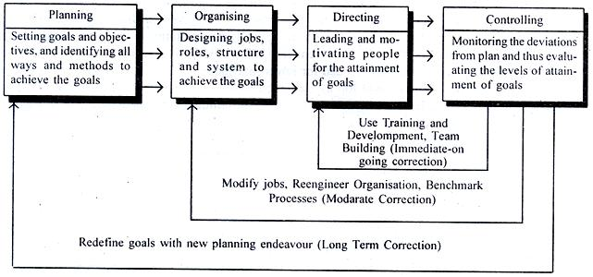
FUNCTIONS OF MANAGEMENT

Slide 28

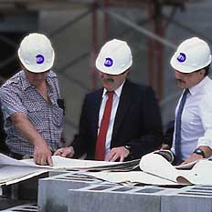
FUNCTION OF MANAGEMENT
1.Planning
Look ahead and chart out future course of operation
Formulation of Objectives, Policies, Procedure, Rules, Programmes and Budgets
Setting firms goals plus the way to accomplish them
A plan is a predetermined course of action which provides purpose and direction of an organization.

Slide 29
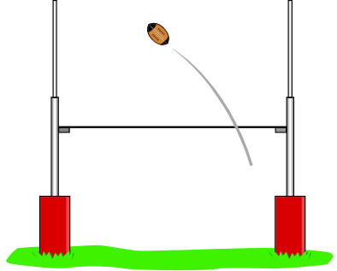
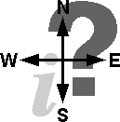
Basic Managerial Functions
Determining organizational goals and means to reach them Managers plan for three reasons.
Establish an overall direction for the organization’s future
Identify and give resources to achieve goals
Decide which tasks must be done to reach those goals

Slide 30
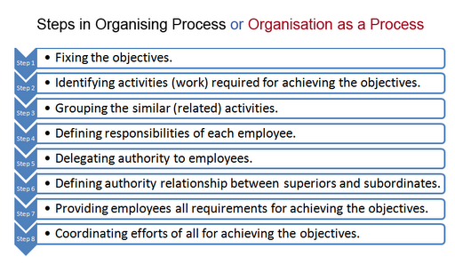
FUNCTIONS OF MANAGEMENT

Slide 31
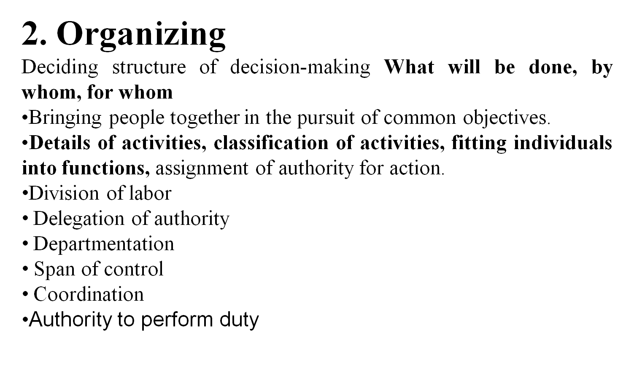
FUNCTIONS OF MANAGEMENT

Slide 32
FUNCTIONS OF MANAGEMENT
3.Staffing
Human Resource Planning(No. and kind of employee etc).
Deciding sources of recruitment(attracting suitable candidate, Internal / external recruitment.).
Receiving applications.
Testing & Interviewing.
Final selection & Appointment letter.
Orientation.
Training & Development.

Slide 33

FUNCTION OF MANAGEMENT
  4. Directing
Act of guiding, managing and leading people.
Motivating employees to achieve firm’s objectives
Motivation (inspire the employee )
Leadership(guide and influence thee behavior of subordinate)
Decision making
Supervision
Communication (for delegation, instruction, two-way, guide, motivate them, formal / informal).

Slide 34

Basic Managerial Functions
5. Controlling
    1.Gather information that measures recent performance
    2. Compare present performance to pre-established standards
    3. Determine modifications to meet pre-established standard
    Establishment of standard
    Measurement of performance
    Appraisal of performance
    Taking corrective action

Slide 35
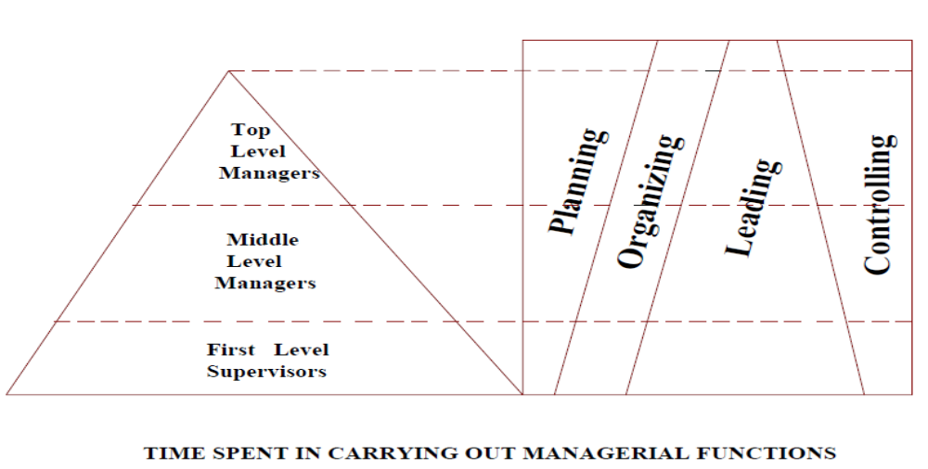
WHAT A MANAGER DOES?
Leadership(guide and influence the behavior of subordinate)

Slide 36
Levels of Management
No of level more if size of the business increase or large
Level should be min otherwise it will create problem.
Because communication process, controlling, coordination will be challenge to managers.
Top
Managers
Middle Managers
First-Line Managers
Non-managers

Slide 37
Organizational Level
Responsibility
Title/Desigination
Making decisions about the direction
of the organization and establishing
policies that affect all organizational
members.
vice president/president/chancellor/
chief operating officer/
chief executive officer/
chairperson of the board
Top
managers
Middle-line
managers
First-line managers
Operatives
Translating the goals set by top
management into specific details
that lower-level managers can perform
Department or agency head/
project leader/ unit chief/
/dean/division manager
Directing the day-to-day
activities of operatives
supervisors

Slide 38
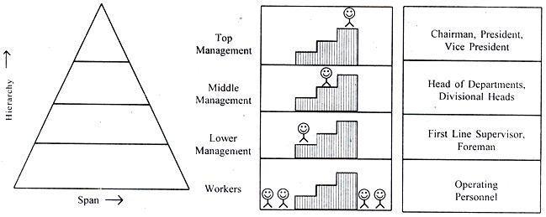
Levels of Management

Slide 39
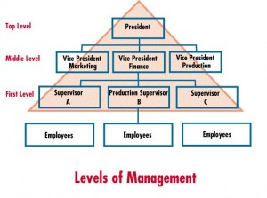
Levels of Management

Slide 40
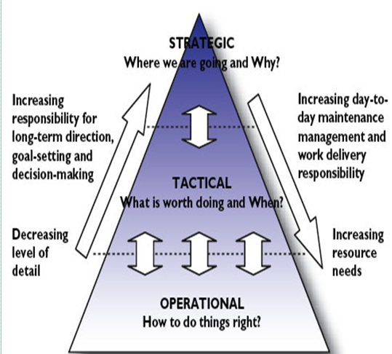
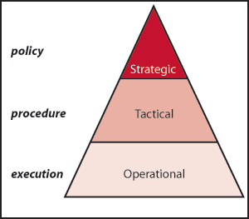
Levels of Management

Slide 41
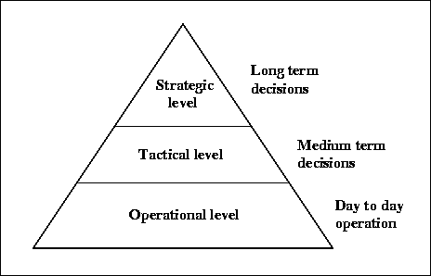
Levels of Management

Slide 42

Basic Levels of management
Top Managers
Chief Executive Officer(CEO), President, Vice President
Responsible for providing the overall direction of an organization
Develop goals and strategies for entire organization
Spend most of their time planning
Communicate with key stakeholders, stockholders, unions, governmental agencies, etc.,
Company policies
Use of multicultural and strategic action

Slide 43
Basic Levels of management
Middle Managers
  Determine which goods or services to provide
  Assistant Manager, Manager (Section Head)
Responsible for setting objectives that are dependable with top management’s goals and translating them into specific goals and plans for first-line managers to implement.
Responsible for coordinating activities of first-line managers
Establish target dates for products/services to be delivered
Need to coordinate with others for resources
communication, teamwork, planning and administration competencies to achieve goals
Develop leaders for the future by broad training and experience

Slide 44
Basic Levels of management
First-line Managers or supervisors
Have direct responsibility for producing goods or services Foreman, supervisors, clerical, accountant
Spend little time with top managers in large organizations
Technical expertise is important
First line managers or supervisors represent link between management and the workers.
Provide training to the workers, supervise and guide the workers
Solve the problem of workers by top level management

Slide 45
What are Managerial Competencies/capability
What are Managerial ability/skills/qualities Important?
Foresight (open minded, forecast, predict the problems which might be faced by the business in near future)
Maturity (emotionally mature, balanced temperament, should have high frustration tolerance)
Technical knowledge (other wise subordinates may misguide)
Human relation attitude (social understanding, maintain good relation solve the problem, help them. treat as human being not as machine.)
Education (mgmt/admin knowledge)
Intelligence (Ability to think, predict, analyze the problem accurately)
Leadership (Manager can motivate if he has leadership qualities)

Slide 46
A Model of Managerial Competencies
A Model of Managerial Competencies
Communication
Competency
Managerial
Effectiveness
Teamwork
Competency
Planning and
Administration
Competency
Global
Awareness
Competency
Strategic
Action
Competency
Self-Management
Competency

Slide 47
MISTAKES OF MANAGERS
Insensitive, unapproachable, harassment
Unfriendly, arrogant (proud, superior, overconfidence)
3. Untrustworthy (unreliable, dishonest)
4. Too ambitious, playing politics
5. Specific performance problems
6. Over managing -- not delegating
7. Ineffective staffing
8. Can’t think strategically
9. Can’t adapt to different bosses
10. Over dependency on mentor (guru, teacher, guide, advisor)

Slide 48
Managerial Skills
Management is a challenging job. It requires certain rainbow skills to accomplish such a challenge.
The job of a manager demands a combination of many types of skills, whether he belongs to business organization, educational institution, a hospital or a club.
Thus, essential skills which every manager needs for doing a better management are called as Managerial Skills.
-The degree (amount) of these skills varies (changes) from levels of management and from an organization to organization.
S/w- Technical Max.
-Manager is to resolve, coordinate the various view points and pool the talents of people working under him towards the organizational goals.

Slide 49
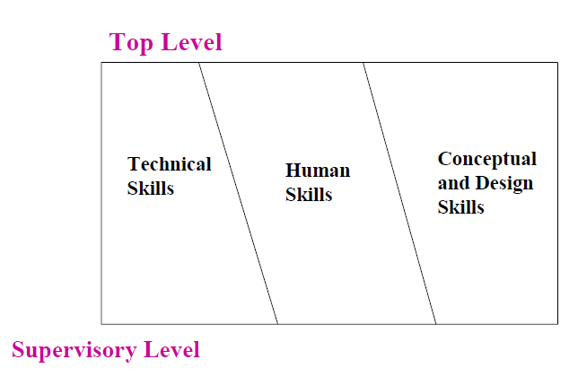
Managerial Skills
Manager also has to plan and organize the operations of the enterprise so that the subordinates are able to use the resources in the best possible manner. For this, he must use the various skills in appropriate degrees.
R. L. Katz has defined three types of managerial skills as follows:
Conceptual skills
Human skills
Technical skills

Slide 50
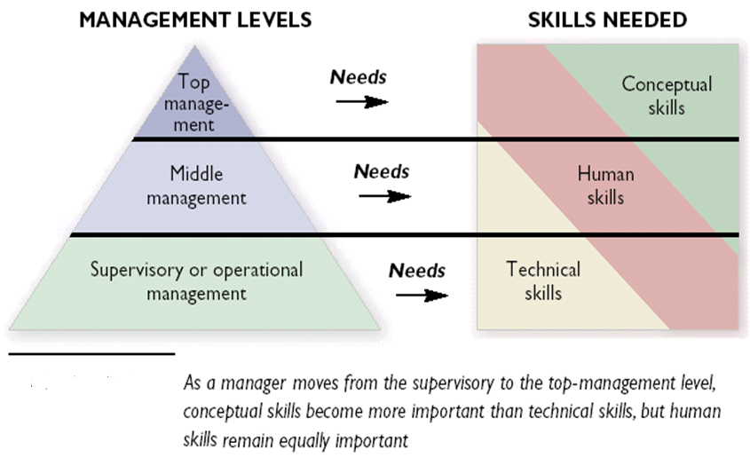
Management Level and Skills

Slide 51
Conceptual Skills
A manager needs conceptual skills to recognize the interrelationships of various situational factors and therefore, make decisions that will be in the best interests of the organization.
Conceptual skills are used for abstract thinking, planning, ideas and strategy formulation.
Conceptual skill is the ability to see the organization as a whole.
Most important at higher levels of management and much less important at lower levels.

Slide 52
Human Skills
Human relations skills are also called Interpersonal skills.
It is an ability to work with people. It helps the managers to understand, communicate and work with others.
It also helps the managers to lead, motivate and develop team spirit.
Human relations skills are required by all managers at all levels of management.
-As all work is done when people work together, human relations skills are equally important at all levels of management.

Slide 53
Human Skills
To win cooperation of others and build effective work teams.
Social understanding, maintain good relation solve the problem, help them. treat as human being not as machine.
Sensitive to the needs & motivations of his superiors, subordinates and peers.
To Resolve conflicts.

Slide 54
Technical Skills
Managers need technical skills to guide and train sub-ordinates.
They can not handle their subordinates if they do not know how the jobs are done.
Technical skills are related to working with tools.
knowledge how to operate the machine like computer and any other machine.
Examples of technical skills are writing computer programs, completing accounting statements, analyzing marketing statistics, writing legal documents, or drafting a design
Calculation and prepare financial statement like balance sheet and income statement etc.

Slide 55
Technical Skills
Technical skills includes specialized knowledge & proficiency in handling methods, processes and techniques of specific jobs
Most important at lower levels of management and much less important at upper levels.
Supervisory managers must train their subordinates in the proper use of work – related tools, machines and equipment.
Now a days, some authors have added two more skills in the previous list. These are:
Analytical Skills.
Administrative skills.
Communication Skills
Digital Skills

Slide 56
Analytical Skills
Analytical skills refer to abilities to proceed in a logical, step-by-step and systematic manner to examine the various aspects of a specific issue.
Helping in problem solving & decision making.
Helping in evaluating performance and to manage complex situations.
Ability to take a large quantity of data and analyze into trends / results

Slide 57
Administrative Skills
Administrative skills are required at the top-level management.
The top-level managers should know how to make plans and policies. They should also know how to get the work done.
They should be able to co-ordinate different activities of the organization.
They should also be able to control the full organization.
To Co-ordinate diverse activities and to regulate organizational events in an orderly manner.

Slide 58
Communication Skills and Digital skiills
Communication Skills
Communication skills are required equally at all three levels of management.
A manager must be able to communicate the plans and policies to the workers.
Similarly, he must listen and solve the problems of the workers. He must encourage a free-flow of communication in the organization.
Digital Skills
These are important because using digital technology substantially increases a manager’s productivity.
Computers can perform in minutes tasks in financial analysis, HRP, and other areas that otherwise take hours, even days to complete.

Slide 59
Roles of a Manager by Henery Mintzberg
(10 Roles)
1.Interpersonal roles
Figurehead:
Symbolic duties as head of the organization
All social, inspiration, legal and Official Responsibility, makes speeches.
In this light, the manager is seen as a symbol of status and authority.
Leader:
Motivates,inspire,set an example.
Promoting and encouraging their development, and balancing effectiveness.

Slide 60
Interpersonal roles
Liaison/Relationship:
Develops and maintains a network of external contacts to gather information
Maintain relationship with other organisations,government,industry groups etc.
One must network and engage in information exchange to gain knowledge.

Slide 61
2.Informational Roles
Mangers as Monitors:
gathers internal and external information relevant to the organization
Observes, collects and reviews data on the meeting of standards.
Managers gather information in order to be well informed.
2.Managers as Disseminators:
Transmits factual and value based information to subordinates
Transmits information and judgment about external and internal environment/sources.

Slide 62
2.Informational Roles
3.Managers as Spokespersons or Representatives of the Organization:
Communicates to the outside world on performance and policies.
Speak for the organization, defends.
Engages in public relations.

Slide 63
3.Decisional Roles
Managers as Entrepreneurs:
Designs and Initiates changes, Set goals, Formulates plans in the organization
They are initiators, innovators, and designers of improvement projects that direct and control change in the organization.
Managers as disturbance handlers:
Handles conflicts and complaints
Managers react to situations that are unexpected, such as mass absenteeism, resignation of subordinates, or losing of customers.

Slide 64
3.Decisional Roles
Managers as Resource Allocator:
Approves budgets, schedules and programmes.
Set priorities.
Managers as Negotiators:
Works out agreement with customers, suppliers and agencies.

Slide 65
Interpersonal Relationship Role
This part encompasses three roles:
Role | Description | Identifiable Activities
Figurehead | Symbolic head; obliged to perform a number of routine duties of a legal or social nature | Greeting visitors; signing documents
Leader | Responsible for the motivation and activation of employees; responsible for staffing, training, and associated duties | Performing virtually all activities that involve subordinates
Liaison | Maintains self-developed network of outside contacts and informers who provide special treatment and information | Acknowledging mail; performing other activities that involve outsiders

Slide 66
Informational Role
The informational roles also include three roles:
Role | Description | Identifiable Activities
Monitor | Emerges as nerve center of internal and external information about Information. | Reading periodicals and reports; maintaining personal contact.
Disseminator | Transmits information received from other employees to members of the organization. | Holding informational meeting; making phone calls to relay information.
Spokesperson | Transmit information to outsiders on organization’s plan, policies, actions, results, etc. | Holding board meeting; giving information to the media.

Slide 67
Decision Making Role
The decisional roles include four roles:
Role | Description | Identifiable Activities
Entrepreneur | Searches for development opportunities in the dynamic environment and initiates “improvement projects” to bring about change. | Designing and initiating changes within the organization.
Disturbance handler | Responsible for corrective action when organization faces important disturbances. | Taking corrective action in nonroutine situations.
Resource allocator | Responsible for the allocation of organizational resources of all kinds. | Performing any activity that involves budgeting and the programming of employees’ work.
Negotiator | Responsible for representing the organization at major negotiations. | Participating in negotiations with other parties.

Slide 68
The Evolution of Management
Thought
Development or Progress of Management Thought

Slide 69
HISTORICAL BACKGROUND OF MANAGEMENT
There are many examples from past history that illustrates how management has been practiced for thousands of years.
The Egyptian pyramids and the Great Wall of China are good examples of projects of great scope and magnitude that employed tens of thousands of people.
How was it possible for these projects to be completed?
•. Ever Since Down Of civilization.
•Administration of Mohenjo-Daro & Harappa Cities Of ancient Aryan in 2000 B.C.
•Buddha order and the sangha
•Organizations of public life in ancient Greece.

Slide 70
EVALUATION OF MANAGEMENT THOUGHT
-In Greece the existence of council, courts, administrators and board of generals indicates the nature of management.
Organization of roman catholic church.
Through the use of the scalar principle and the delegation of authority, the city of Rome was expanded to an efficient empire.
•Organization of military forces.
Confucius-proper public administration, appoint honest, unselfish and capable public officers.

Slide 71
EVALUATION OF MANAGEMENT THOUGHT
Industrial revolution(1760-1820,England)
Increase the demand of production
Can be thought of as possibly the most important pre-twentieth century influence on management.
The introduction of machine powers, combined with the division of labor, made large, efficient factories possible.
Planning, organizing, leading, and controlling became necessary.

Slide 72
EVALUATION OF MANAGEMENT THOUGHT
Contributions of Industrial revolution
Large scale production by machine in place of hand tools.
Cottage system of production was greatly replaced by the factory system. the factories gave employment to a large number of workers. so need of managers to handle these workers.
The invention of steam engine enabled man to drive the machines by power.
Growth of engineering industries
Rise of chemical industries
Revolution in iron making
Transport facilities increase

Slide 73
Pre-classical Contributors
Adam Smith
  Published “The Wealth of Nations” in 1776
    Advocated the division of labor (job specialization) to increase the productivity of workers
Charles Babbage(1792-1871)
Leading British mathematician at Cambridge university
Method of science and maths should be applied in the factories to solve the problem.
He was a mathematical management scientist, interested in division of labor, scientific methods.

Slide 74
SCIENTIFIC MANAGEMENT ERA
SCIENTIFIC MANAGEMENT ERA (F.W Taylor, Henery Gantt, Frank Gilbreth, Emerson)
After Industrial revolution
Machine theory or traditional theory, structural theory of organization, anatomy of formal organization
To solve the problem of management
First systematic study of mgmt
  Fredrick Winslow Taylor The “father” of scientific management
  Published Principles of Scientific Management (1911)
  Using scientific methods to define the “one best way” for a job to be done

Slide 75
SCIENTIFIC MANAGEMENT ERA
  Having a standardized method of doing the job
  Putting the right person on the job with the correct tools and equipment
  Providing an economic incentive to the worker
-Increased production, quality control, cost reduction, Elimination of wastes, supreme importance to organization,
Its main objective was improving economic efficiency, especially labor productivity.
Reasons of Low Efficiency of Workers
•Lack of Knowledge on the part of management as to how much work should be done by a worker in a day.

Slide 76
SCIENTIFIC MANAGEMENT ERA
SM or Taylorism involves-
PRINCIPLES OF SCIENTIFIC MANAGEMENT
To enhance Productive efficiency of each worker-Principles
to be followed
1) Science, not rule of thumb- traditional mgmt(decision are based on opinions, intuition or rule of thumb)
2)Harmony(Agreement),not discord (disagreement , conflict).
3)Co-operation (to change mental attitude /mental revolution/mutual trust and confidence), not individualism
4) Maximum output, in place of restricted output.
5)Development of each man to his greatest efficiency & prosperity.

Slide 77
SCIENTIFIC MANAGEMENT ERA
6)Equal division of work and responsibility between management and labour. (manager for planning and worker for execute them)
Technique Developed -To implement these Principles
1)ELEMENT OF SCIENTIFIC MANAGEMENT
Determination of workload (work study) by-
Method study (to know the best method of doing a particular job),
Time study (standard time taken for any operation),
Weakness /Fatigue/low energy/tiredness study or Motion study (Reduce wasteful motions. some element of a job can be eliminated, combined, their sequence change)

Slide 78
SCIENTIFIC MANAGEMENT ERA
2)Proper selection, placement and training of workers by a centralized personnel department.
(selection process is faulty-right worker not on the right job)
3.IMPROVEMENT IN METHODS OF WORK
i) Standardization of materials, tools and equipment, working conditions, methods for improve the quality of production.
ii) Regulation of speeds of machines.
iii) Improvement of the work environment.
4.Scientific task setting (A fair day’s work)
5-setting of wage/pay/salary/income/earning

Slide 79
SCIENTIFIC MANAGEMENT ERA
Differential Piece Rate System
Taylor observed that workers did as little work as possible. He felt that under existing wage system, an efficient worker gained nothing extra. So, Taylor used the differential piece (unit) rate system.
Under differential piece rate system, a standard output was first fixed. Then two wage rates were fixed as follows :-
Low wage rate was fixed for those workers who did not produce the standard output.
Higher wage rate was fixed for those workers who produced the standard output or who produced more than the standard output.

Slide 80
SCIENTIFIC MANAGEMENT ERA
Differential piece-rate system can be explained with following example :-
The standard output for a day is 10 units. The wage rate for producing less than 10 units is $ 5 per unit, and for producing 10 or more units is $ 8 per unit. If Mr. X produces 7 units, and Mr. Y produces 12 units, then their wages will be as follows :-
Mr. X's wage is 7 x 5 = $ 35
Mr. Y's wage is 12 x 8 = $ 96
Because of this system, the inefficient workers will try to improve their efficiency, and the efficient workers will be motivated to maintain or improve their production capacity.

Slide 81
SCIENTIFIC MANAGEMENT ERA
Mental Revolution
Taylor introduced the concept of "Mental Revolution".
He said that the management and workers should have a positive attitude towards each other.
This will result in close cooperation between them. This will increase productivity and profits.

Slide 82
SCIENTIFIC MANAGEMENT ERA
Fatigue and Motion Study
Frank and Lillian Gilbreth (Husband and Wife) introduced fatigue and motion studies. Fatigue and motion studies find out and remove unnecessary and wasteful movements while doing the job.
According to the Gilbreths, fatigue (tiredness) and motion (movements or actions) are interlinked.
Every motion that is removed will reduce weakness. They found that the workers do many wasted motions while doing their work. This resulted in low energy.
So, the Gilbreths asked the workers to stop all unnecessary motions and to do only the motions which were necessary for doing the job.
Therefore, productivity of workers increased.

Slide 83
SCIENTIFIC MANAGEMENT ERA
Taylor separated planning from doing. At the planning level there were four supervisors. They are :-
Time and Cost Clerk : This boss prepares the standard time for completing the work and cost of doing that work.
Route Clerk : This boss makes the exact route (way) through which each product has to travel from a raw-material to a finished product.
Discipline Clerk : This boss looks after the discipline and absenteeism problems in the organisation.
Instruction Card Clerk : The boss gives instructions about how to do a particular work.

Slide 84
SCIENTIFIC MANAGEMENT ERA
At the Doing Level :-
At the doing level there were also four supervisors. They are
Gang Boss : He is responsible for setting up the machines and tools and for direct supervision of workers.
Speed Boss : He is responsible for maintaining a proper speed of work.
Repair Boss : He is responsible for the repairs and maintenance of machines.
Inspector Boss : He is responsible for maintaining the quality of production.

Slide 85
SCIENTIFIC MANAGEMENT ERA
Advantage to employers-
1-Replacement of traditional rule of thumb method by scientific investigation
2.Proper selection and placement of the workers leading to better performance in every context
3.Harmonious relationship between the workers and mgmt.
4.Standard tools, methods, materials etc.
5.Better utilization of resources and elimination of wastes.
6.Scientific determination of fair work a worker can do during the day.

Slide 86
SCIENTIFIC MANAGEMENT ERA
Advantage To workers-
-Detailed instructions and constant guidance for the workers
-Training and devt to increase skills.
-Incentive wages to the workers for higher production.
Advantage To Society-
-Better quality products at lower costs to the people
-Higher standard of living of people through better products.
-Increased productivity in the country
-Technological development due to scientific investigation
How Do Today’s Managers Use Scientific Management?
  Use time and motion studies to increase productivity
  Hire the best qualified employees
  Design incentive systems based on output

Slide 87
CRITICISM OF SCIENTIFIC MANAGEMENT
Speeding up of workers (SM attempt to force them to work their max)
Boredom (routine work just like automatic machine)
No scope for initiative (order-have to do, No innovation, Employee were supposed to obey their superiors ,No new work method)
Exploitation of workers (Mgmt is a clear device for the exploitation of the workers, salary not increased as production increase)
it is said that the focus of this theory on “organization without people”
Focus on only production, not on marketing, human, accounting, finance etc.

Slide 88

General Administrative Theory
General Administrative Theory

Slide 89

Fayol’s Fourteen Principles of Management
  Functional Management Approach
  Henri Fayol (France)-Mining Engg
  Henri Fayol, a French industrialist, is now recognised as the Father of Modern Management.
  -The father of management process or administrative management school
  -Fourteen Principles of Management: Fundamental or universal principles of management practice
    Management as an universal process

Slide 90
General Administrative Theory
In year 1916 Fayol wrote a book entitled "Industrial and General Administration". (1916 in French, translated into English in 1949) .
In this book, he gave the 14 Principles of Management.
These 14 principles of management are universally accepted and used even today.
According to Henri Fayol, all managers must follow these 14 principles.

Slide 91
Fayol’s Fourteen Principles of Management
General Administrative Theory
Division of work
Authority
Discipline
Unity of command
Unity of direction
Subordination of the individual
Remuneration
Centralization
Scalar chain
Order
Equity
Stability of tenure of personnel
Initiative
Esprit de corps (Union is strength)

Slide 92
Fayol’s Fourteen Principles of Management
1-Division of work-
-Among various individuals
-Specialization of labor
-Avoid waste of time
-job enlargement /growth for job satisfaction
2.Remuneration/payment/fee/wages of personnel
For their services
Should be fair to everybody
It should include both financial and non-financial incentives.

Slide 93
Fayol’s Fourteen Principles of Management
3-Authority and Responsibility
Denotes the right or power to give the orders to the subordinates.
Responsibility means the duty which the subordinate is expected to perform.(Ex-No of units of a product)
According to Henri Fayol, there should be a balance between Authority (Power) and Responsibility (Duties).
Authority must be equal to Responsibility.
If the authority is more than responsibility then chances are that a manager may misuse it.
If responsibility is more than authority then he may feel frustrated.

Slide 94
Fayol’s Fourteen Principles of Management
4.Discipline-
Discipline means a respect for the rules and regulation of the organization.
Code of conduct, ethical norms of society
Discipline may be Self-discipline, or it may be Enforced discipline.
Self-discipline is the best discipline. However, if there is no self-discipline, then discipline should be enforced through penalties, fines, etc.
No organization can survive without discipline.
Getting obedience to rule and regulations of the organization.
Essential for the smooth running of the organization.
Depend upon leadership quality, clear and fair agreement, no divide and rule, coordination ,mental support.

Slide 95
Fayol’s Fourteen Principles of Management
5.Unity of command
A subordinate must receive orders from only one superior. In other words, a subordinate must report to only one superior.
Dual command is a permanent source of conflict. conflict among the superiors
It helps clarify authority-responsibility relationship in the organization.
No possibility of receiving conflicting orders.
Who is responsible to whom
According to this principle, a subordinate (employee) must have only one superior (boss or manager).

Slide 96
Fayol’s Fourteen Principles of Management
According to Fayol, if one subordinate receives orders from more than one superior then there will be disorder.
This will affect the discipline, efficiency, productivity and profitability of the organisation.
Unity of Command is a very important principle of management.
This principle is based on the rule "Too many cooks spoil the soup."

Slide 97
Fayol’s Fourteen Principles of Management
6.Unity of Direction
All activities which have the same objective must be directed by one manager, and he must use one plan. This is called Unity of Direction.
For example, all marketing activities such as advertising, sales promotion, pricing policy, etc., must be directed by only one manager.
He must use only one plan for all the marketing activities.
One unit and one plan
Group of activities having the same objective or directed towards its common goal.
Functioning of a department, sub dept or the organization as a whole.

Slide 98
Fayol’s Fourteen Principles of Management
7.Subordination of Individual Interest to the general interest
In an organization, there are two types of interest, viz., the individual interest of the employees, and the general interest of the organisation.
The individual interest should be given less importance, while the general interest should be given most importance. If not, the organization will fail.
The interest of the organization must prevail upon the personal interests of individuals. (both toward Goal)

Slide 99
Fayol’s Fourteen Principles of Management
8.Scalar Chain
Scalar Chain is a line of authority. This line joins all the members (managers and employees) from top to bottom.
Every member must know who is his superior. He must also know who is his subordinate.
Scalar Chain is necessary for good communication. Scalar Chain must not be broken in standard situations.
However, if quick action is necessary, then this chain can be broken. This is done using "Gang Plank" / "Bridge" / "Direct Contact".
Scalar Chain is shown in diagram below with Gang plank as dotted line FP.

Slide 100
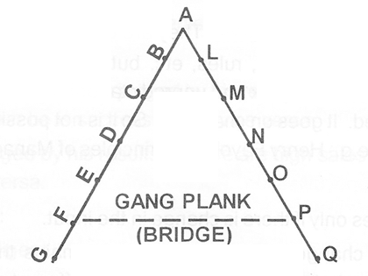
The Scalar Chain is shown by a double ladder A to G and A to Q. A is the head of the organisation. B and L are the next level, and so on.
If quick action is necessary, then a "Gang Plank" "FP" is made.
Now F and P can contact each other directly but they should inform E and O about their decisions.

Slide 101
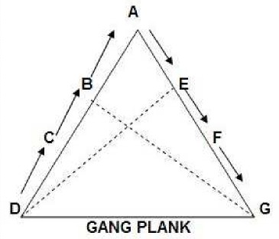
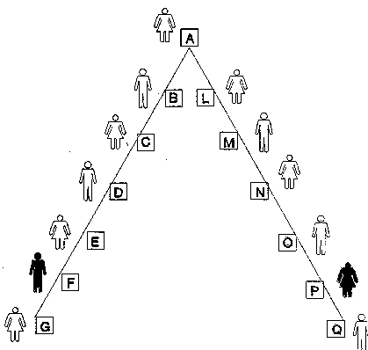
Fayol’s Fourteen Principles of Management
-Take more time from top to bottom communication
-Distortion of message as every superior from top to bottom, may add and delete, edit something.
-Communication should be min (Short-circulating chain for quick communication gang plank

Slide 102
Fayol’s Fourteen Principles of Management
9. centralisation
In centralisation, the authority is concentrated only in few hands.
However, in decentralisation, the authority is distributed to all the levels of management.
No organisation can be completely centralised or decentralised.
If there is complete centralization, then the subordinates will have no authority (power) to carry out their responsibility (duties).
Similarly, if there is complete decentralisation, then the superior will have no authority to control the organisation.
Therefore, there should be a balance between centralisation and decentralisation.

Slide 103
Fayol’s Fourteen Principles of Management
10.Order
A place for everything and everything in its place (order of employee i.e. social order, order in materials things)
Employee must be at appointed place
Right person on the right job and right place
There should be an Order for Things and People in the organization. Order for things is called Material Order.
Order for people is called Social Order.
Material Order refers to "a place for everything and everything in its place."
Social Order refers to the selection of the "right man in the right place". There must be orderly placement of the resources such as Men and Women.
Misplacement will lead to misuse and disorder.

Slide 104
Fayol’s Fourteen Principles of Management
11.Equity/Fairness/Impartially
Fair judgments in dealing wd human resources.
person must be treated wd kindness.
superiors should be good natured, soft spoken
Impartiality creates loyalty ,reliability and devotion in the employees.
12.Stability of tenure/term of personnel
An employee needs time to learn his job and to become efficient.
Therefore, he should be given time to become efficient. When he becomes efficient, he should be made permanent.
In other words, the employees should have job security.
Employee should not be rotate at different jobs very frequently

Slide 105
Fayol’s Fourteen Principles of Management
13.Initiative
Management should encourage initiative.They should encourage the employees to make their own plans and to execute these plans.
This is because an initiative gives satisfaction to the employees and brings success to the organisation.
very important and essential

Slide 106


Fayol’s Fourteen Principles of Management
14. Esprit de corps (Union is strength)-
Esprit de Corps means "Team Spirit".
Therefore, the management should create unity, co-operation and team-spirit among the employees.
They should avoid the divide and rule policy.
Harmonious human relation
Avoid written communication (Use face to face contacts tend to promote speed, clarity and harmony)

Slide 107
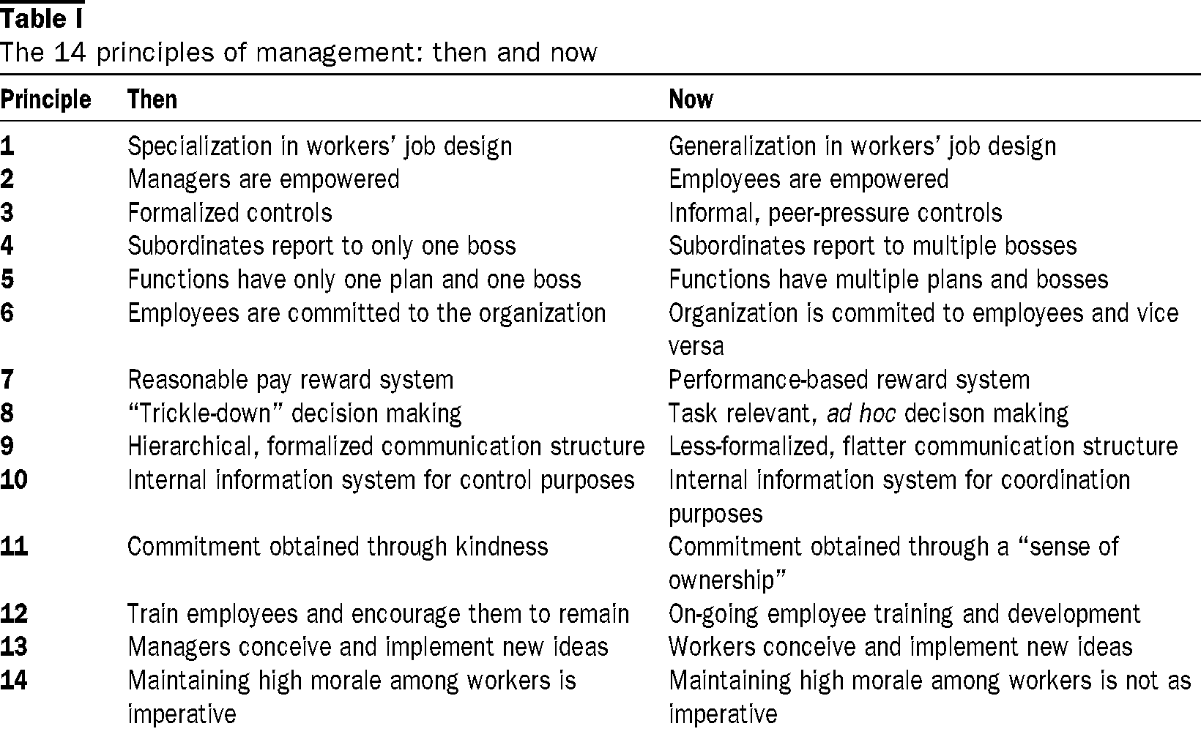

Slide 108
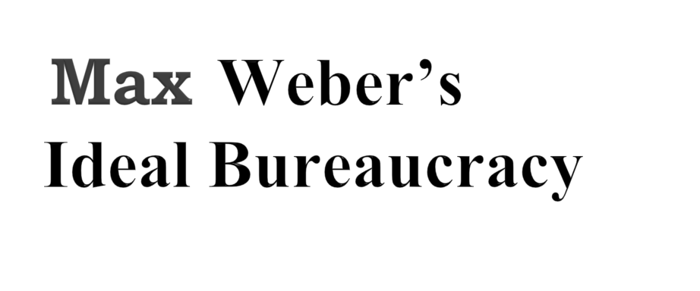
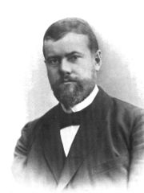
By: Marissa Madrigal, Beau Hindman, Amy Wrenn

Slide 109
Weber’s Ideal Bureaucracy
Meaning-system of government, official procedure, administration
In the 1930s Max Weber, a German sociologist
A group of workers (for example, civil service employees of the U. S. government), is referred to as "the bureaucrats.“
Bureaucracy has an informal usage, as in "there's too much bureaucracy where I work." This informal usage describes a set of characteristics or attributes such as "red tape" or "inflexibility" that frustrate people who deal with or who work for organizations they recognize as "bureaucratic."
Max Weber's principles spread throughout both public and private sectors.

Slide 110
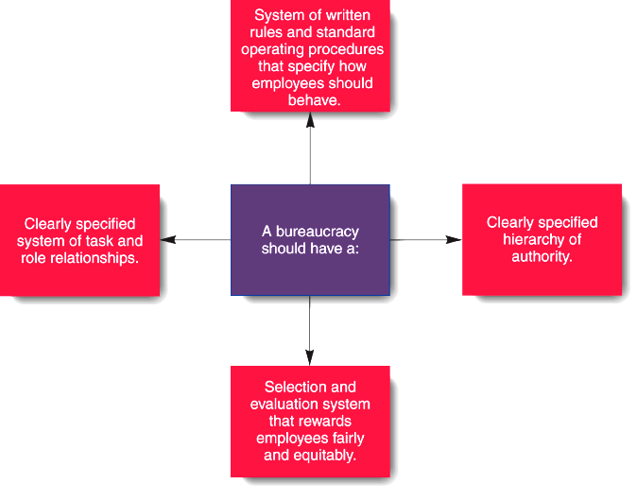
Weber’s Principles of Bureaucracy
Weber’s Ideal Bureaucracy

Slide 111
Weber’s Ideal Bureaucracy
The idea is to treat all employees equally and customers equally, and not be influenced by individual differences.
A Clear hierarchy -. All positions within a bureaucracy is structured in a way that allow the top positions to manage and control the lower positions.
This allows for a clear chain of command, control and order organization.
Division of labor and specialization - All responsibilities in an organization are specialized, so that each employee has the expertise to make a special task.

Slide 112
Weber’s Ideal Bureaucracy
Intangible relationships between managers and employees - Leaders must maintain an unfriendly relationship with employees so that Partiality and personal biases do not access decisions.
Interpersonal relations are based on positions and not on personalities.
Only Bureaucratic or legal power is given importance.
Competence, skills - Should be the basis for all decisions made-up in hiring, work assignments, and promotions in adjustment to Advance ability and merit as the main characteristic of a bureaucratic organization.
Selection and Promotion is based on Technical qualifications.

Slide 113
Weber’s Ideal Bureaucracy
Records - The bureaucracy should be continued for the complete files regarding to all activities.
There are well defined Rules and Regulations. There rules cover all the duties and rights of the employees. These rules must be strictly followed.
There are well defined Methods for all types of work.

Slide 114
Weber’s Ideal Bureaucracy
Bureaucratic organization is criticized because of the following reasons :-
It does not give importance to human relations.
Too much emphasis on rules and regulations. The rules and regulations are rigid and inflexible.
It is suitable for government organizations. It is also suitable for organizations where changes are very slow.
But it is not suitable for business organizations because business organizations believe in quick decision making and flexibility in procedures.
It is appropriate for static organizations.
Bureaucratic organization is a very rigid type of organization.

Slide 115
Weber’s Ideal Bureaucracy
No importance is given to informal groups. Nowadays, informal groups play an important role in all business organizations.
Bureaucracy involves a lot of paper work. This results in lot of wastage of time, effort and money.
There will be unnecessary delay in decision-making due to formalities and rules.
Too much importance is given to the technical qualifications of the employees for promotion and transfers. Dedication and commitment of the employee is not considered.
There is limited scope for Human Resource (HR).

Slide 116
Classical Approach
Classical Approach/functional approach/management process approach/administrative mgmt approach-
1.Scentific Management (Taylor)
2.Administrative or functional management (Henri Fayol)
3.Bureaucracy(Max Weber)
-One of the oldest approach to management
-Concentrate on organization structure and their mgmt
-They concentrate on work planning, the technical requirement, principles of mgmt.
-known as structural framework of organization

Slide 117
Classical Approach
-Taylor suggested scientific method to solve mgmt problem
-Fayol 14 principles of mgmt and their universal applications Contribution of classical approach
-Focus on division of labour, Scalar chain, Functional processes
-Focus on the managerial experiences and implementation
-They ignored the role of human element
-Money is considered the main motivator under this theory
-Centralization of authority.
-

Slide 118
Classical Approach
--Organization as a closed system, no interaction with the external environment.
-Based on past managerial experiences and their limited observations.
-Strict rules and regulation.
If conflict, the interest of the organization should prevail.
-Classical writers emphasis on the universality of mgmt principles but in practice, mgmt principles can not be applied blindly, they may need modifications according to situation.

Slide 119
Neo-Classical or Human Relations Theory
-This theory is a reaction to the classical approach.
--This theory focused on the human aspect of Industry, -Human factor is the most important resources of organization
-focus on inter-personal relations at the work place
-Manager must take interest in the welfare of workers.
-Elton Mayo is as Father of the Human relations school
-Conducted some experiments known as Hawthorne experiments
Chester Barnard
  Saw organizations as social systems that require human interaction and cooperation.
  Expressed his views in his book “The Functions of the Executive (1938)”.

Slide 120
Neo-Classical or Human Relations Theory
    Robert Owen-(1771-1858)
  Father of personnel management
  Scottish businessman and reformer who advocated for better treatment of workers.
  Relieve human sadness/unhappiness.
  was a British factory owner who advocated concern for the working and living conditions of workers
  He made provisions for reduced working hours, housing facilities, education of workers and their children, human treatment to workers.
Mary Parker Follett
  Management therefore involves getting things done with and through people.
  Organizations viewed as individuals and group behavior.
  Believed that individual potential could only be released by group association.

Slide 121
Neo-Classical or Human Relations Theory
it focused on the following :
Man is a social animal and he never thinks alone. He is greatly influenced by what others with whom he is associated thinks or behaves.
Human relations, through team work, seeks to fulfill both individual and organizational objectives simultaneously
Form small informal group and leader can fix norms, recognition, behavior, performance of workers.
Thus it is the group that sets the pattern of human behavior.
Improve relations with workers.
A focus on people, rather than upon machines or economics
-Importance of employee satisfaction—a satisfied worker was believed to be a productive worker.

Slide 122
Neo-Classical or Human Relations Theory
-Making management practices more humane.
A key activity in human relations is motivating people and their job satisfaction
  Abraham Maslow
  Douglas McGregor
The core of human relations approach is "being nice to workers”.
It is necessary to study the organizational behavior as a whole, involving the study of the attitude, behavior and performance of both individuals and groups in organizational setting.

Slide 123
Neo-Classical or Human Relations Theory
Hawthorne Experiments-
-1927-1932 by Elton mayo and associates
-Western Electric company, Chicago
The human relations movement drew heavily in support of its findings on a series of famous experiments called the Hawthorne Studies which were conducted at the Hawthorne Plant of the Western Electric Company
The neglect of human aspect and over- emphasis on machines, materials and abstract functions led to the development of this approach.
Prof. Elton Mayo is considered as the initial profounder of the Human Relations or Behavioral Approach to Management

Slide 124
Neo-Classical or Human Relations Theory
Hawthorne Experiments-
-Illumination/light/lighting/experiment
-Effect of lighting on employee o/p
-One group in room where lighting remain constant / Second group where lighting varied (over voltage, under voltage, not proper supply, intensity of light )
-O/P of both group increased
Result-it was concluded that lighting was a minor factor. there were some other factors which influenced the productivity of workers when the intensity of light was increased or decreased.

Slide 125
Neo-Classical or Human Relations Theory
2.Relay assembly (meeting / get-together) test room experiments-
-Test group of six female workers, frequent changes were made in their working conditions such as shorter working hours, rest periods, hot lunch, friendly interaction among members of the group, free social interaction among group members.
-Result-Productivity increased,
-
Socio-psychological factors like feelings, recognition, participation having greater influence than working condition for higher productivity.

Slide 126
Neo-Classical or Human Relations Theory
3.Mass interview Programme
-A large number of workers were interviewed by the researchers to understand their attitude, opinion on work, working conditions etc.
Result--
Attention on happiness of employee
-The Hawthorne studies suggested that happy employee will be more productive employee.

Slide 127
Neo-Classical or Human Relations Theory
Contribution of Human relations or Neo-classical Approach
Role of money-
-Money is not every thing to motivate
-Socio-psychological factor act as important motivator
-Conflict between organizational and individual goals
For the smooth functioning of the organization, it is necessary to achieve the integration between the goals of the organization and those of the individuals
Communication
-Both way communication is necessary
-Space for feelings and sentiments, moral /ethical support

Slide 128
Neo-Classical or Human Relations Theory
-Group Dynamics/cluster/set
-Workers often do not act or react as individuals but as members of groups
-The groups plays an important role in determining the attitude and performance of individual workers.
Social system
-Organization in general is a social system composed of interacting parts.
-The workers follow a social norms determined by their co-workers, which defines the proper amount of work
-Social env. Affects and affected by workers
-A family, a village, a political party a trade union is all social groups.

Slide 129
Neo-Classical or Human Relations Theory
Criticism of Neo-classical approach-
Invalid Assumption
-Assumption that there is a solution to every problem which satisfies everyone is not true
Lack of scientific Validity-
-The groups chosen for study were not representative in character.
-The findings based upon temporary groups
Limited Application
-Application is limited not universal to all organization.
Limited Focus on work
-Focus on interpersonal relations and on the social groups

Slide 130
Neo-Classical or Human Relations Theory
Over concern with happiness
-Attention on happiness of employee
-The Hawthorne studies suggested that happy employee will be more productive employee.
-It is possible a lot happiness but unproductive workers

Slide 131
APPROACHES TO MANAGEMENT
APPROACHES TO MANAGEMENT
1) Empirical Approach
2) Human Behaviour Approach
3) Social System Approach
4) Decision Theory Approach
5) Mathematical Approach
6) Socio-Technical Systems Approach
7) Systems Approach
8) Contingency Approach
9) Operational Approach

Slide 132
APPROACHES TO MANAGEMENT
Empirical/Experimental/practical approach
•Features
-Mgmt is the Study of past managerial experiences and cases
-Past experiences as lesson for the future.
–Study of Successful & failure cases help managers.
–Learning through experience of others
-Knowledge and experiences of successful managers can be applied by other managers in problem solving and decision making.
•Limitations–Situations of past not the same as present.
Contributors:
Earnest Dale, Mooney & Reiley, Urwick.

Slide 133
APPROACHES TO MANAGEMENT
Contingency/ common sense /Situational School(1950)
-Also known as a common sense approach. If -Then approach.
  Organizations are individually different, face different situations (contingency variables), and require different ways of managing.
The environment is relatively uncertain
The technology is complex and dynamic.
-The goals are diverse and changing.
The impact of environment on the organization structure and managerial style is the major concern
-It rejects the blind applications of principles.
–Depends on situation.
–Each organization is to be studied as a unique entity.

Slide 134
APPROACHES TO MANAGEMENT
Contingency/Situational School Defined
  It suggest that no organizational design may be suitable for all situations.
There are many non-routine activities in which creativity and innovation are important.
-Particular action is valid only under certain conditions.
There is no one universally applicable set of management principles (rules) to manage organizations.

Slide 135

APPROACHES TO MANAGEMENT
DECISION THEORY APPROACH
•Manager –Decision maker and problem solvers.
•Organisation–Decision making unit.
•Features
Management is decision making.
Decision making -control point in management
Increasing efficiency -the quality of decision
•Contributors
–Simon, Cyert, Forrester, etc.
•Uses
–Tools for making suitable decisions in organizations.
•Limitation
–Does not take the total view of management
–Decision making -one aspect of management

Slide 136
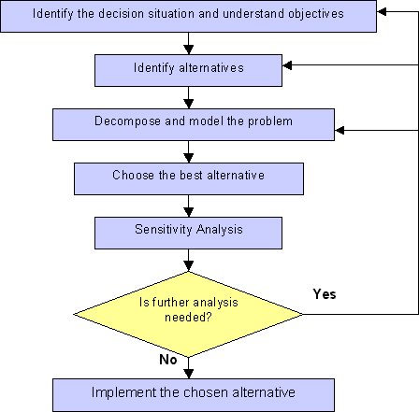
APPROACHES TO MANAGEMENT
Decision Making Model In Five Steps
1.State the problem
2. Identify alternatives
3. Evalute the alternatives
4. Make a decision
5.Implementation of the decision
-An alternative is (uniquely) best if and only if it is better than all other alternatives.
-If there is a uniquely best alternative, choose it.

Slide 137
APPROACHES TO MANAGEMENT
SYSTEMS APPROACH (1960)
-Organization is a system composed of interrelated and interdependent elements.
-The system does not exist in a vacuum. it receive information, material and energy from other systems as inputs.
-An organization is a dynamic system as it is responsive to its environment.
--Environment (e.g. technological, social, economic, and political, competition in the market)
-It does not comment on the validity of the classical principles of management.

Slide 138
The Systems Approach
Basic Types of Systems
  Closed systems
  -Self-dependent, self-contained, self-maintaining unit
    Are not influenced by and do not interact with their environment
    Ex- physical and mechanical systems are closed system.
    Concentrate on internal relationships between subsystems
    Open systems
    Dynamically interact to their environments by taking in inputs and transforming them into outputs that are distributed into their environments

Slide 139
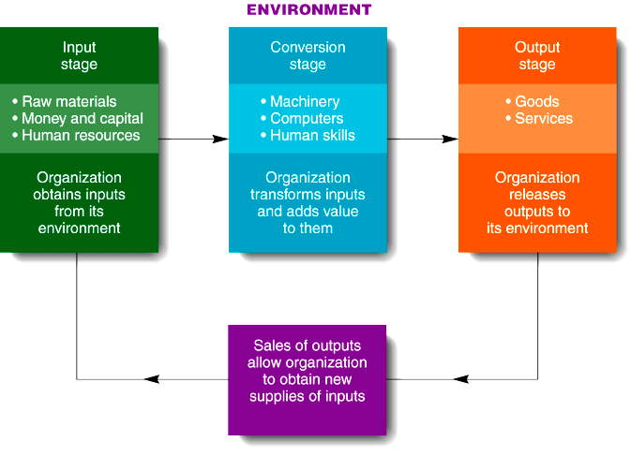
APPROACHES TO MANAGEMENT

Slide 140
APPROACHES TO MANAGEMENT
  For example, living organisms are considered open systems. Humans, for example, inhale oxygen out of the environment and exhale carbon dioxide into the environment.
  -Whereas, say, a human living in a house where he can get deliveries, that's an open system
  Similarly, some organizations consume raw materials in the production of products and Produce finished goods and pollution as a result.
  In contrast, a watch is an example of a closed system in that it is a relatively self-contained, self-maintaining unit that has little interacts or exchange with its environment.

Slide 141
APPROACHES TO MANAGEMENT
-Imagine, say, a human in a house, that is perfectly insulated from the world and has no mechanism of bringing ANYTHING new in. That would be a 'closed system'.
World-various national economy-industries-firm-production, accounting, finance etc.
The world considered a system in which various national economies are subsystems. each economy is composed of its various industries, each industry is composed of firm, a firm can be considered a system with subsystems such as production. marketing, finance, accounting etc.
Ex.-Internet, Organization, Democracy
-Composed of a hierarchy of subsystems.
-System-subsystem-further sub system
-Input, Process and Output

Slide 142
implications of the Systems Approach
APPROACHES TO MANAGEMENT
-Coordination of the organization’s parts is essential for proper functioning of the entire organization.
-Decisions and actions taken in one area of the organization will have an effect in other areas of the organization.
-Organizations are not self-contained and therefore, must adapt to changes in their external environment.

Slide 143
APPROACHES TO MANAGEMENT
SOCIAL SYSTEM APPROACH
-Chester Barnard father of social system approach.
-Almost same as Human relations approach.
-Organization as a social/collective/shared system that is composed of people who work in cooperation.
- Employee cooperate, communicate, work for a common purpose
•Understanding the behavior of groups & individuals.
•Features
1.Social System, a system of cultural relationship
Cultural relations may be defined as interactions, both direct and indirect, among two or more cultures.

Slide 144
APPROACHES TO MANAGEMENT
Formal/official/proper Organization -Cultural relationships of social groups working within the organization.
2.Co-operation necessary
3.Efforts directed –harmony (agreement/synchronization) between goals of organization & goals of groups.
4.Organizational decisions should not be based on desires of one group alone but should reflect the interests of all the parties.

Slide 145
SOCIAL SYSTEM APPROACH Contd…
•Contributors/Thinkers
–Pareto, Chester Barnard
•Uses
–Organizational decisions should not be based on desires of one group alone but should reflect the interests of all the parties.
•Limitations
–Miss\ ignore many management concepts principles & techniques that are important to practicing managers.

Slide 146

BUSINESS ETHICS
&
SOCIAL RESPONSIBILITY

Slide 147
ETHICS
Ethics comes from the Greek root “ethos” which means character, guiding beliefs, standards or ideals for group and community.
-Ethics mean :what is good or bad, fair or unfair, Right/Wrong for group, culture, or nation or while doing the business.?
Ethics may be defined as-
  That set of moral values /Moral code/Principles
  Business Ethics refer to the moral/good/right/decent/honest principles which should govern business activities.
-Code of conduct for the managers.
-Guide the human to perform their job ethically \ fairly \ decently \ morally.

Slide 148
Example of Ethical business practices-
To charge fair prices from the customers.
To pay taxes to the government honestly.
To charge reasonable profits from the customers.
- To give fair treatment to the workers.
-Business should follow the ethical or moral norms of the society.
-Ethical values in business operations.
Honest dealing with every one.
-if a manager is just and fair in his action, his behavior will be deemed to be ethical.
Unethical practices
-Sale of products injurious to public health. Ex.- charas, heroine
-False claims in advertisement
-Exploitation of workers
-Plain water in injection
-Duplicate products under popular brand names.
-Using company property for personal use.

Slide 149
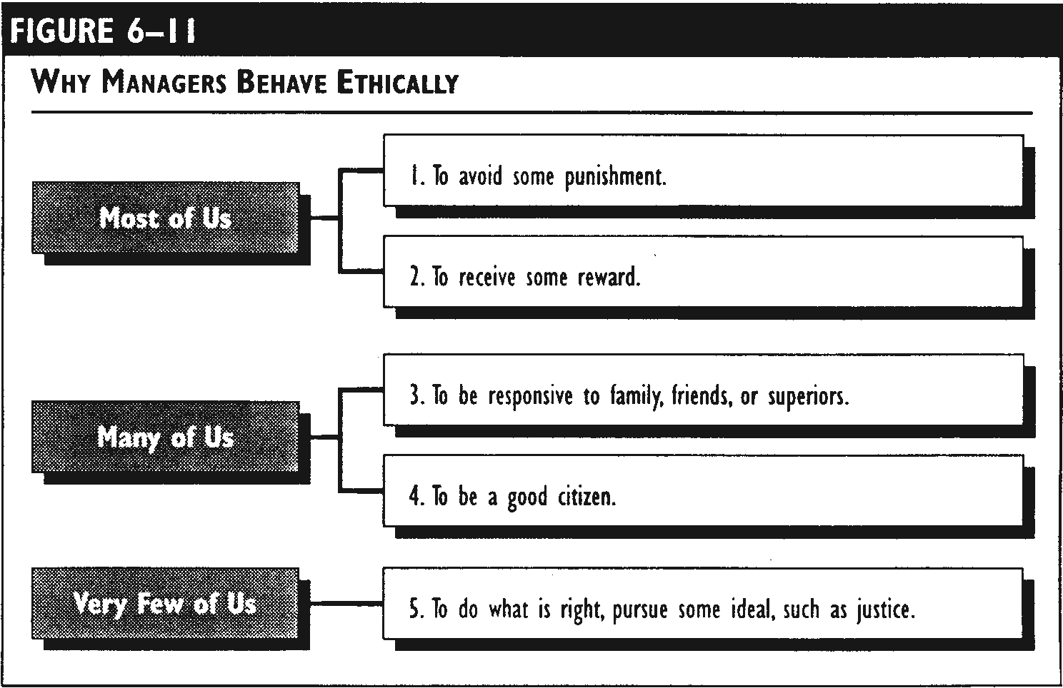
Business Ethics and management
  Ethics may be Business ethics, medical ethics, legal ethics etc.

Slide 150
Business Ethics and management
Business Ethics importance-
-Business is a part of the society. social values must become the guiding principles for doing business.
-Organisation fail and not at society's expectations, it may lose its image, market share.
-Managers must respect the social norms and expectations.
-If a business is not ethical, govt can take action .
Equity-fair and reasonable treatment to all.
Honest business, responsible citizen
-Sense of right and wrong

Slide 151
Sources of Ethical Norms
Fellow Workers
Institutions
Regions of Country
Family
Profession
The Individual
Ethics
Friends
Employer
The Law
Religious Beliefs
Society at Large

Slide 152
Business Ethics and management
Factors influencing the Ethical behaviour
1.Social factors -social values, norms, traditions, customs.
2.Economic factors -immoral advertisement for profit
3.Cultural factors -cultural values, family system, religion, education,
4.Political factors -business ethics are also influenced by the ideology and philosophy of the political party in power.
5.Organisational factors.
6.Institutional codes

Slide 153
Tools for promoting Ethical Practices
1.Mission statement-the objective of the organization, What business wants to be?
2.Core Values-based on its vision and mission. core values like impartiality, fairness, technical excellence, respect between co- workers.
3.Policies and procedures should be based on ethical values.
4.Code of conduct or code of ethics
-Have the support of top management,
-Be clearly explained to all employee
-Be practical and realistic
Watchdog committee that has authority to take disciplinary action.

Slide 154
Business Ethics and management
5.Grievance/Complaint handling mechanism
-For proper implementation of the code of ethics and conduct.
6.Dilemma resolution workshops and Ethical training
-Ethically dilemma resolution workshop should be organized from time to time to prepare the participants for dealing with ethical dilemmas in future in an effective manner.
7. Establishing Ethical climate of firm

Slide 155
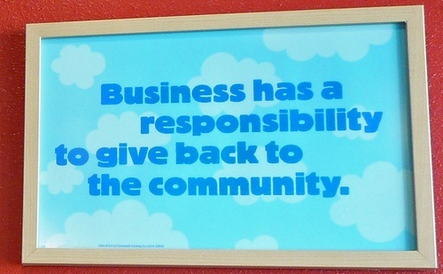
SOCIAL RESPONSIBILITY
Social responsibility refers to a firm’s obligation to act for benefit of society.
-It is based on the assumption that what is good for the society.
--Several corporations have been engaged in discharging their social responsibility.

Slide 156
SOCIAL RESPONSIBILITY
-A business enterprise must try to understand the goals of the society of which it is a part and take steps to contribute towards the achievement of those goals.
-Act in a manner which will serve the best interests of the society.
Classical view of social responsibility
Business is an economic institution and major responsibility is to produce more goods and earn more profit to owners.
Modern view of social responsibility
The business houses are a part of the society, take input and resources from society. so must respond to the social needs and values.

Slide 157
SOCIAL RESPONSIBILITY
J.R.D Tata was the first leading businessman to clearly recognize that business does not operate in isolation from society.
Solve the problems of people
Ex. TISCO has contributed a lot in the areas of community development, social welfare, tribal development, rural industrialization.
“Meeting of minds” SDP/FDP By TCS
-Finolex industries started the Hope foundation in 1979 for the detection and treatment of cancer.
Reliance foundation

Slide 158
SOCIAL RESPONSIBILITY
Companies are taking initiatives for developing infrastructure in rural areas, e.g., TATA Motors provides desks, benches, chairs, tables, computer laboratory, electrical fittings and educational and sports material to various primary schools in Singur.
-Lupin laboratories launched “ Lite for Life” programme in 1973 to control and eliminate tuberculosis from India.
BHEL is also providing drinking water facilities, construction of roads, provision of health facilities, educational facilities, and so on..
-Companies like ONGCs are encouraging sports by placing good players on their pay rolls.
-Microsoft corporation donated $100 million (more than 400 crore) for the containment of AIDS in India.

Slide 159
SOCIAL RESPONSIBILITY
Social responsibility towards different interest groups
1.Responsibility towards Employees
To pay reasonable wages and salaries to its employees so that they may satisfy their needs and lead a good life.
To provide good working conditions to maintain the health of the workers.
Provide services such as medical facilities, child education, life insurance, medical insurance.
Create better human relations in the business.
-Provide equal opportunities to the workers to develop their skills through training and education.

Slide 160
SOCIAL RESPONSIBILITY
2.Responsibility towards Customers
Customer satisfaction is the ultimate aim of all economic activities.
To produce goods which meet the needs of the consumers of different classes.
Goods at reasonable prices.
To handle the customer’s grievances quickly and carefully.
To ensure regular supply of goods and services.
To ensure that advertisement and other statement issued by the business are truthful.
To follow fair trade practices.

Slide 161
SOCIAL RESPONSIBILITY
3.Responsibility towards Government
-Follow the polices or guidelines issued by the government.
-To pay taxes honestly(VAT, Sales tax etc) and in time to the government.
To adopt fair dealing in foreign trade.
4.Responsibility towards community and society
- To promote national integration.
-To preserve and promote social and cultural values.
-To provide high quality product to the society.
- To improve the quality of life of the workers.
To generate employment opportunities.
To ensure Efficient use of national resources.
To take steps against air, water and noise pollution.

Slide 162
Long Questions
1.Explain the concept of management and bring out its importance in present day context.
2. “Management is the effective utilization of human and material resources to achieve the enterprise’s objectives. "comment.
3.Discuss the nature and scope of management. Is management a science or an art or both?
4.Is management a profession? give arguments for and against the professionalization of management.
5.Clearly explain the concept and significance of management. Distinguish between management and administration.
6.How would you argue that management is important for all organizations?

Slide 163
Long Questions
7. “Management is the art of getting things done through people". Comment.
8.Define the term management and explain its basic features.
9.What are the functions of a manager? Briefly explain various managerial skills.
10.Assess the contributions of Henry fayol to management thought.
11.Compare and contrast various theories of management.
which approach would you suggest and why?
12. “F.W.Taylor is said to be the father of scientific management and Henri Fayol, the father of principles
of management." Explain this statement.

Slide 164
Short Questions
1.“The fundamental functions of management are universal. they are applicable to all situations." Discuss.
2.Difference between authority and responsibility.
3.Distinguish between management process, principle and practices.
4.Discuss the contributions of ‘Hawthorne Experiments’ in the development of managerial thinking.
5.Discuss Taylor’s principles of scientific management.
6.What is the contingency approach to management?
7.Diffrences between Human relations and scientific management approach.
8. “Elton mayo is known as the father of human relations school." comment.

Slide 165
Short Questions
9.Write Short notes on the following:
a) Level of management
b)Interpersonal Roles of Managers
c)Managerial skills
d)Management as a Process
e)Management Vs. administration
f)Impotance of management
g)Scientific management
h)Concept of business ethics

Slide 166
Objective questions
1.Which one of the following approaches is adopted in studying management?
a) Profession b) Art
c) Science d) Process
2.Management is
a) Pure Science b) applied science
c) Art d) science and art both
3.The concept of scientific management was given by
a) Frederick Taylor b) Henery Fayol
c) Elton Mayo d) Peter Drucker

Slide 167
Objective questions
4.Management as a system emphasises on-
a) close system perespective
b) open system perespective
c) socio-technical system
d)None of these
5.What is the natur of management process?
a) Time-bound b) Continuous
c) Procedural d) disjointed
6.Top management functions are the most important because these take care of-
a)Overall organisation b)specific problems
c)Routine problem d)extraordinary problems

Slide 168
Objective questions
7.Which one of the following terms is not associated with social responsibilty?
a)Social commitment b) Social concern
c) Social programme d) Social structure
8.Business organisations should feel concerned with social responsibility because they-
Are the part of society b)can make huge profit
c)Can be more efficient d)can complete in better way

Slide 169
Thanks…
REFERNCES:-
Koontz,”Principles of management”,TMH,2008
Robbins and Coulter,”Management”,PHI
L.M.Prasad,”Principles and Practices of management”
T.Ramasamy “Principles of Management.”
Google.co.in etc.

